Slide 1
Graph Alogrithm Finding Bridges
Cuong Nguyen

Slide 2
Content
02
01
02
04
Problems
Introduce
UVA problems
Introduce Finding Bridges
Solve
Question
Solution for problems
Question and answers

Slide 3
01
Introduce

Slide 4
—Answer in next slide
“Who need to learn algorithm Finding Bridges?”

Slide 5
People who need to learn this algorithm
Competitive Programmer
Because this is a classic and popular algorithm in IOI and ICPC competitions.
Job applicants
Many BigTechs can interview this algorithm
(Exam: VNG, Facebook, Google, …)
Computer Science Student
Some university may teach this content
Some others
People like about algorithms

Slide 6
—Question for class
“Tell me what Graph algorithms you learned ?”

Slide 7
—DFS Tree and Applications
“The problem Finding Bridges can solve by DFS algorithm.”

Slide 8
—Recall knowledge
“To understand Finding Bridges, we need to recall some concepts of graphs.”

Slide 9
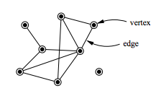
Example Graph
1
Vertex
Is a node in the graph
2
Edge
Is a line connecting two vertices

Slide 10
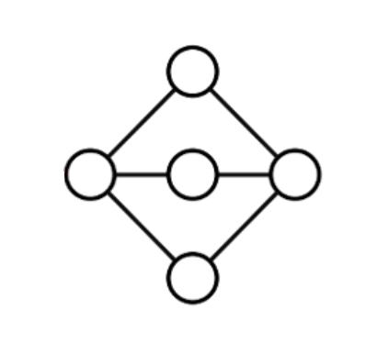
Connected Component
A set of vertices where each vertex can visit every other vertex in the set, and no vertex is connected to any outside the set.

Slide 11
—New knowledge
“What is Bridges?

Slide 12
Bridges
Bridges is a edge if you remove it then increases the number of connected components graph

Slide 13
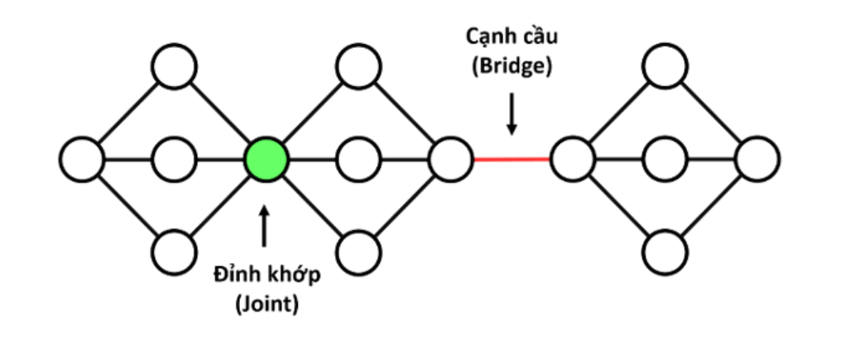
Bridges

Slide 14
02
Problems

Slide 15
Uva Problem: 796 - Critical Links
The network have many servers connected to each other through link.
A critical link is a link that if cut would split the network into two unconnected subnets.
The problem requires find all critical link.

Slide 16
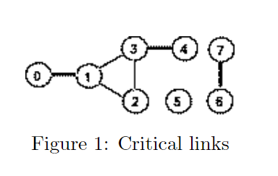
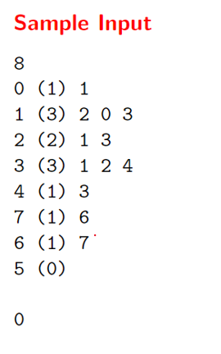
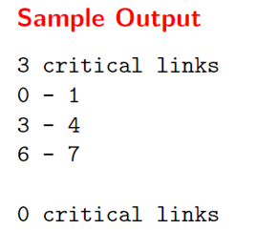
Uva Problem: 796 - Critical Links

Slide 17
03
Solve

Slide 18
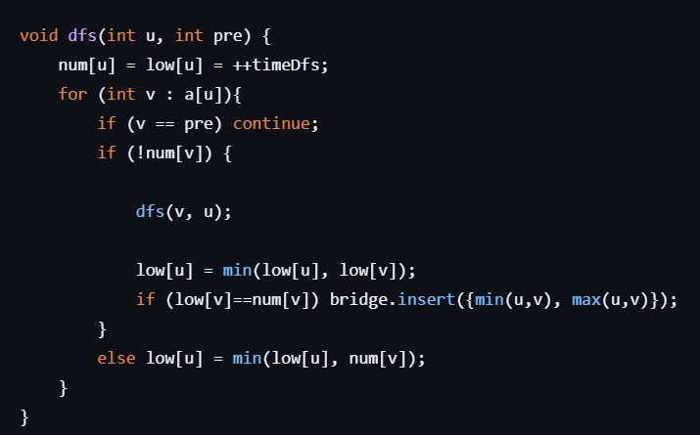
Find Bridges by DFS
Num[u]: index dfs to u (discovery order)
Low[u] : num[i] smallest that can visit from i to u
Fomular:
If (num[v] == low[v])
then (u,v) is bridge

Slide 19
DFS 0 -> num[0] = 0, low[0] = 0
DFS 1 -> num[1] = 1, low[1] = 1
DFS 2 -> num[2] = 2, low[2] = 2
DFS 3 -> num[3] = 3, low[3] = 3
DFS 4 -> num[4] = 4, low[4] = 4
Back DFS 3: (3-4)
low[3] = min(low[3], low[4]) = 3
If Low[4] == num[4] = 4 => bridge 3-4

Slide 20
Back DFS 3 (3 -> 1)
Because 1 was visited -> Low[3] = min(low[3], num[1]) = 1
Back DFS 2 (2 -> 3)
low[2] =min(low[2], low[3]) = 1
Back DFS 1 (1 -> 2)
low[1] =min(low[1], low[2]) = 1
Because 3 was visited => low[1] = min(low[1], num[3]) = 1

Slide 21
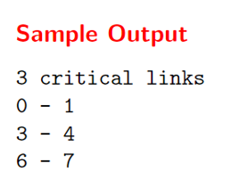
Back DFS 0 (0-1)
Low[0] = min(low[0], low[1]) = 0
If Low[1] = num[1] => bridge 0->1
DFS 6 -> num[6] = 6, low[6] = 6
DFS 7 -> num[7] = 7, low[7] = 7
Back DFS 6 (6-7)
Low 6 = min(low[6], low[7])
If low[6] == num[6] => bridge 6-7

Slide 22
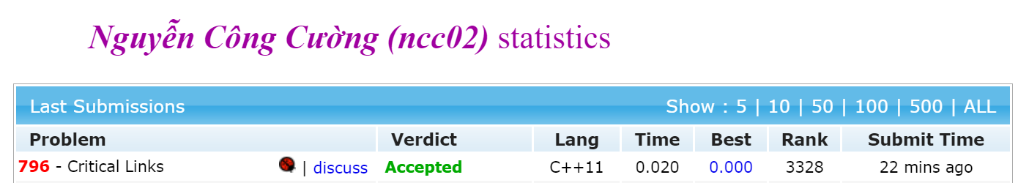
Code was accepted on UVa online-judge
Problem: We can search google “UVA 796” to read full
Code: https://github.com/ncc02/Algorithm (Folder Graph)

Slide 23
04
Question

Slide 24
1
What is type algorithm of Finding Bridges ?
A. Dynamic Programming
B. Geometry
C. Backtracking
D. Graph

Slide 25
1
What is type algorithm of Finding Bridges ?
A. Dynamic Programming
B. Geometry
C. Backtracking
D. Graph

Slide 26
2
The algorithm is suitable for the problem finding bridge in graphs?
A. DFS
B. A*
C. BFS
D. GBFS

Slide 27
2
The algorithm is suitable for the problem finding bridge in graphs?
A. DFS
B. A*
C. BFS
D. GBFS

Slide 28
What is Bridge in Graph ?
3
A. Is a node in the graph
B. A set of vertices where each vertex can visit every other vertex in the set, and no vertex is connected to any outside the set.
C. Is a line connecting two vertices
D. Is a edge if you remove it then increases the number of connected components graph

Slide 29
What is Bridge in Graph ?
3
A. Is a node in the graph
B. A set of vertices where each vertex can visit every other vertex in the set, and no vertex is connected to any outside the set.
C. Is a line connecting two vertices
D. Is a edge if you remove it then increases the number of connected components graph

Slide 30
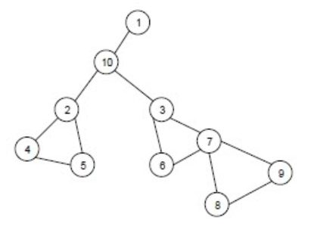
4
How many bridges in the Graph ?
A. 1
B. 2
C. 3
D. 4

Slide 31
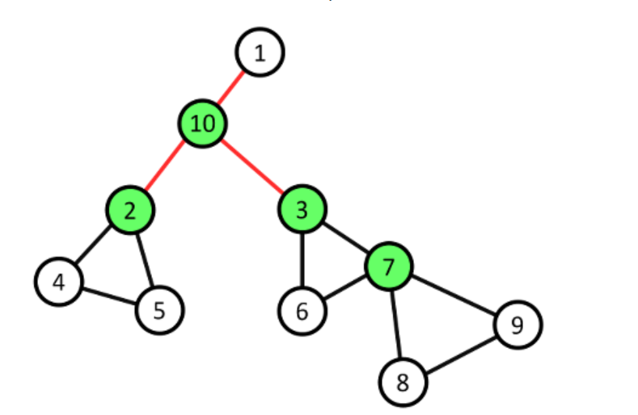
4
How many bridges in the Graph ?
A. 1
B. 2
C. 3
D. 4

Slide 32
Thanks!

